Slide 1

CS427 Embedded Systems
19102697 nourhane abdelalem
19102749 bassant yasser
19103642 seham mahmoud
19100683 yara adel hassan

Slide 2
poster

Slide 3
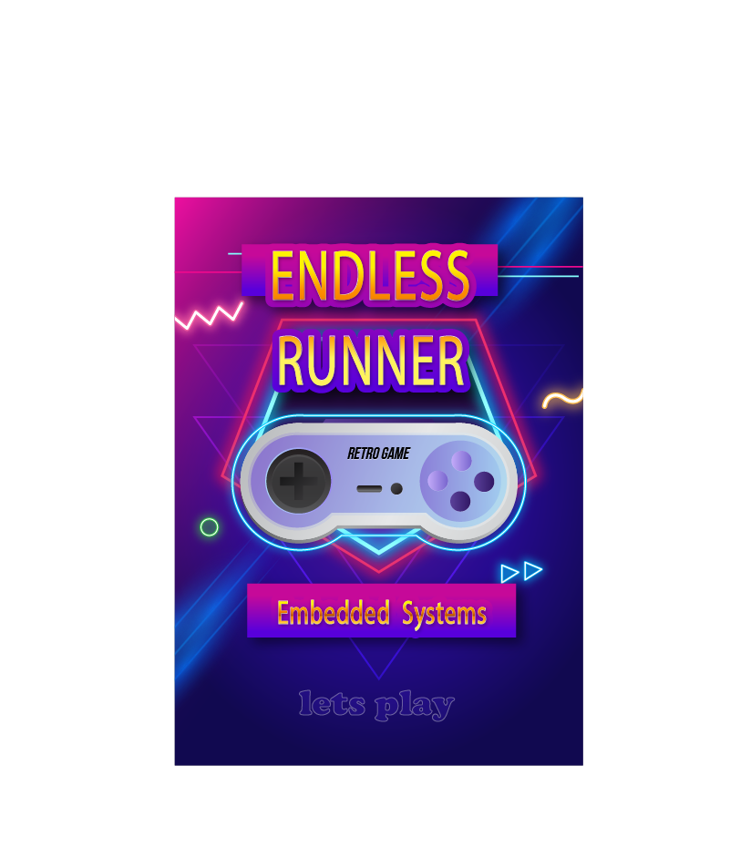
poster

Slide 4
components

Slide 5
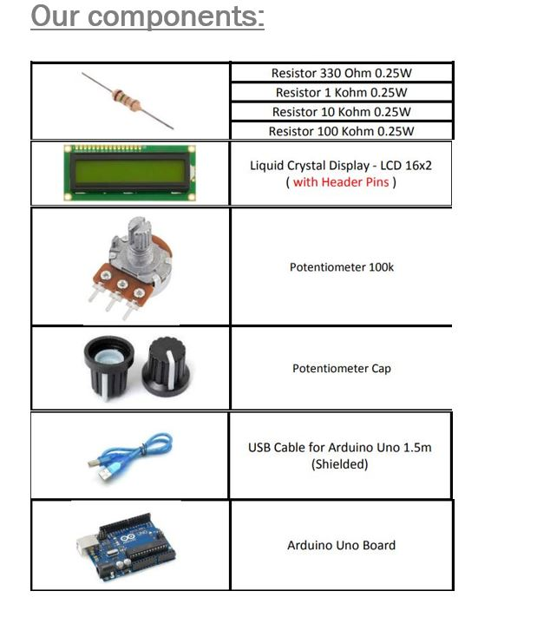
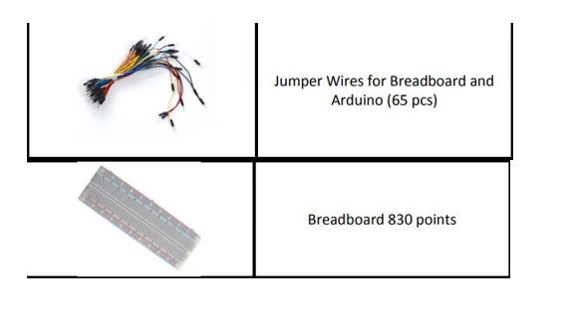

Slide 6
Our system

Slide 7
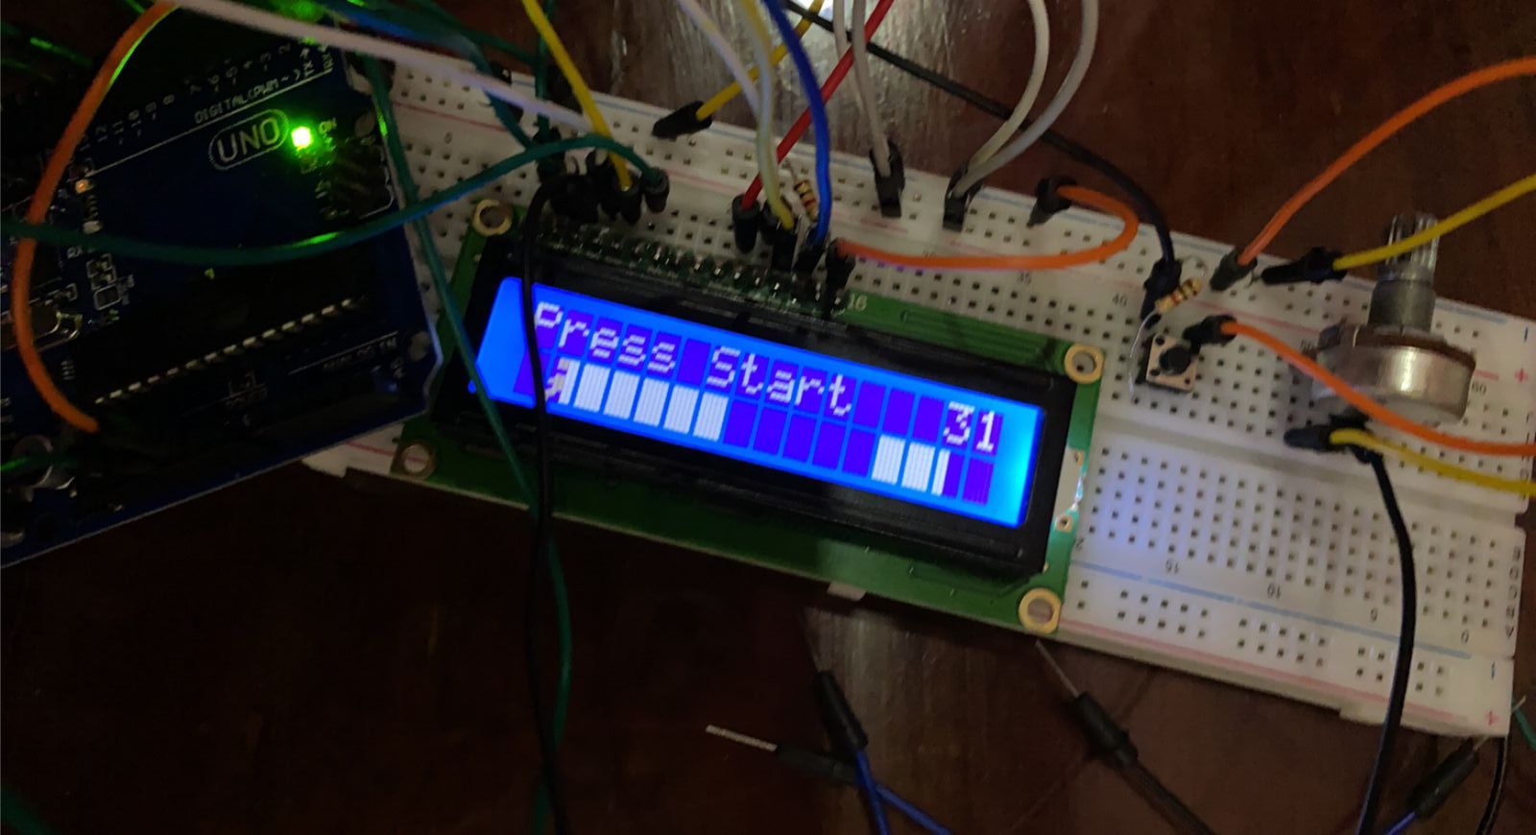
system

Slide 8
multisem

Slide 9
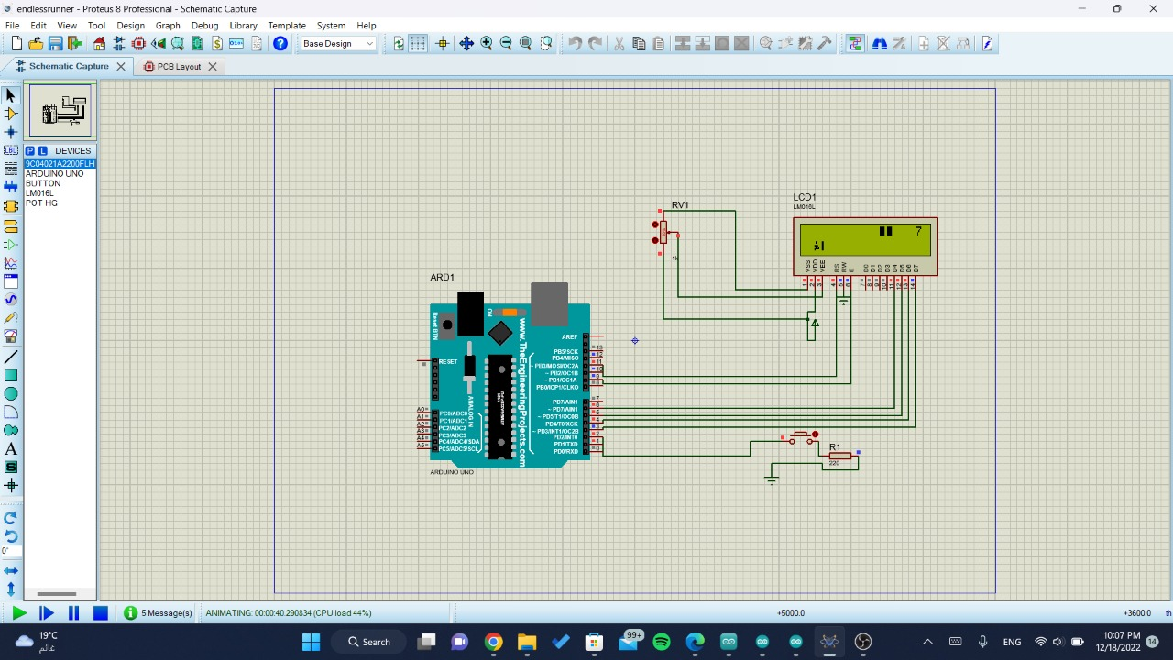
system

Slide 10
simulation

Slide 11
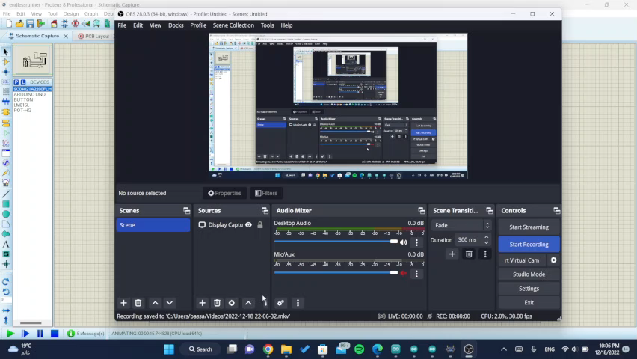
simulation

Slide 12
running

Slide 13
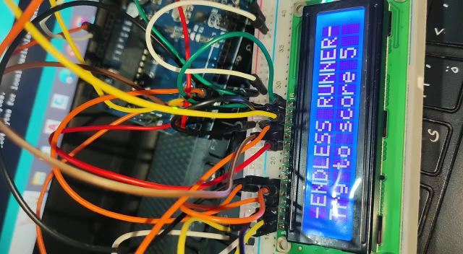
Actual run

Slide 14
Win state

Slide 15
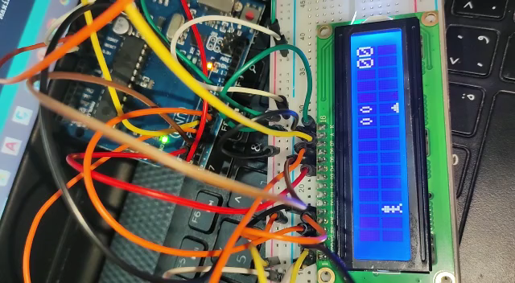
Win simulation

Slide 16
lose state

Slide 17
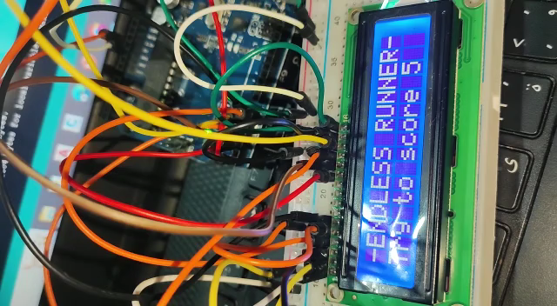
Lose simulation

Slide 18
Marketing plan
Since 2010 people intended to purchase more laptops than pcs as they where catchy but after 5 – 7 years people went back to their roots . statistics said pcs made a very good come back inn the market . which made software companies starts to re develop pcs to be more efficient than before
Facing trend strategies and according to marketing statistics games are less purchased nowadays due to high pricing so we managed to develop[ most common games in a low price ith limited resources .

Slide 19
Testing plan
Brain stormed the concept
Ideation and research
Writing the code
Cost analysis to choose the right component resources
Purchasing the components
Settling the bored
Uploading the code on the Arduino
Verifying the code “it runned succesfully”
Displaying the player and the obstacles
Testing the win and lose states
Setting a marketing plan for the product

Slide 20
Supervised by: DR. Mohamed el Habrok
Thank you
Yara adel
Siham mahmoud
Bassant Yasser
Nourhan abdelalem

